Slide 1
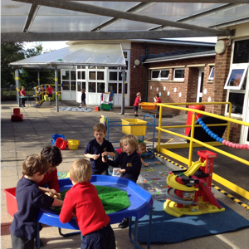
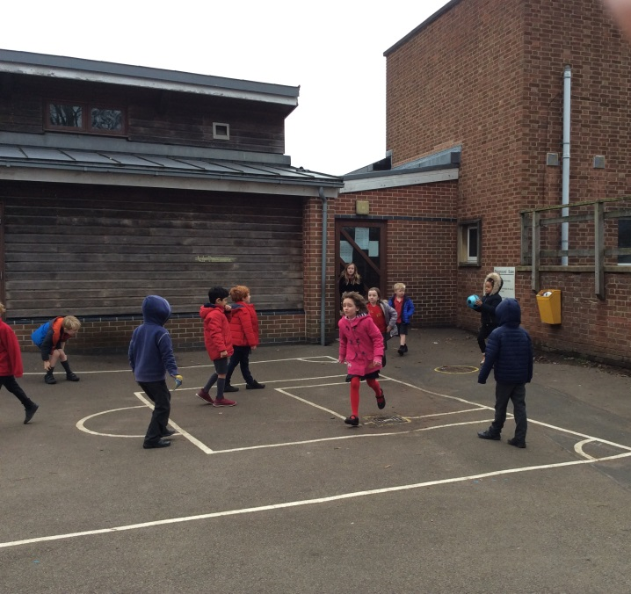
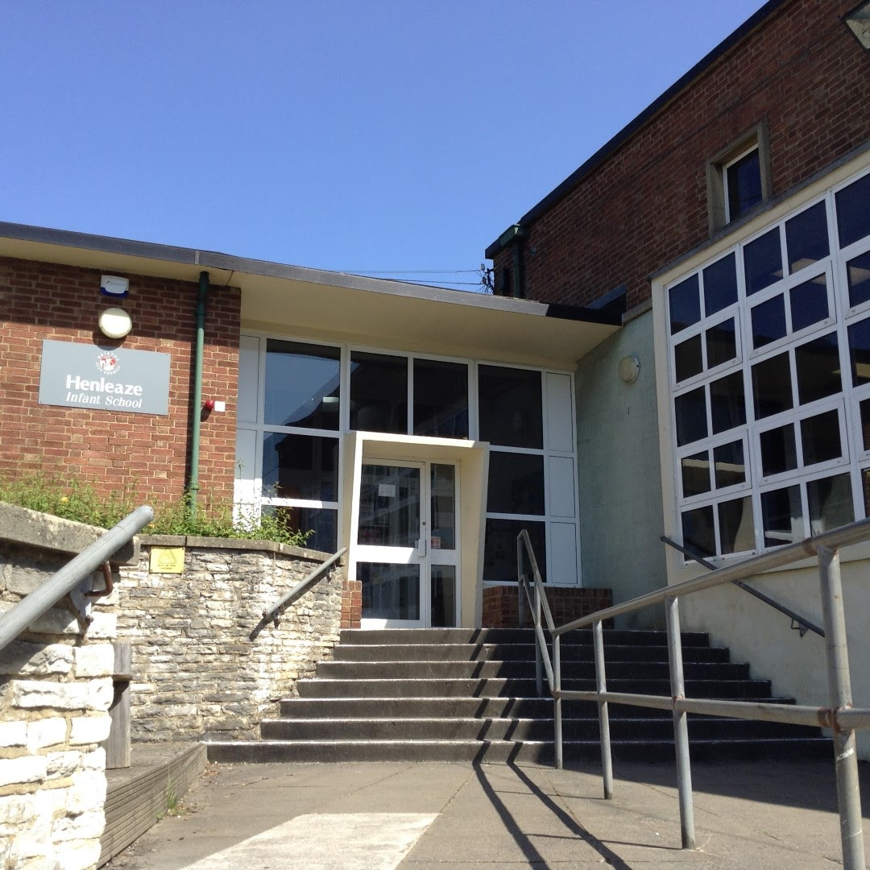
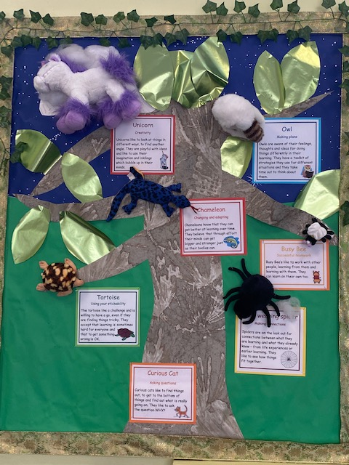
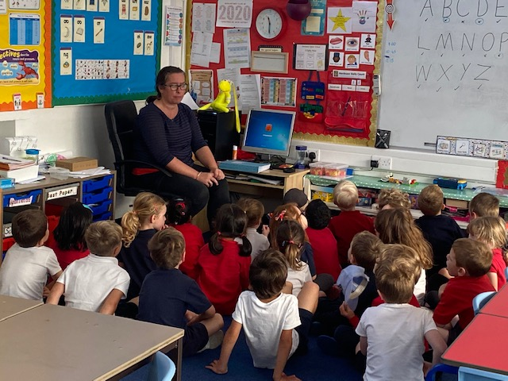
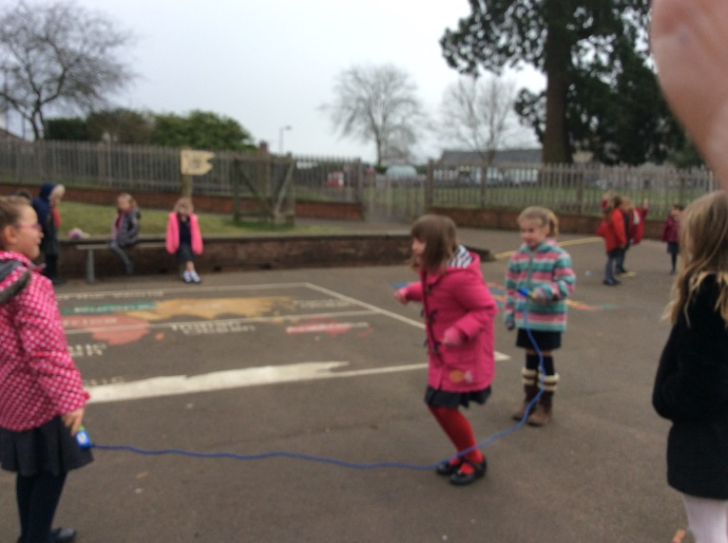

Slide 2
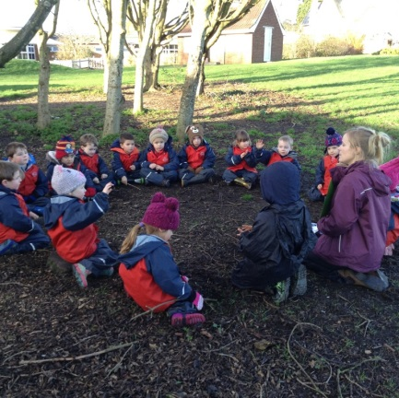
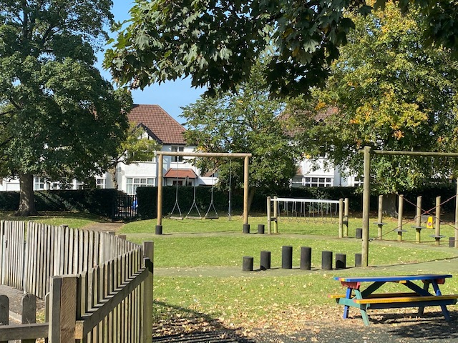
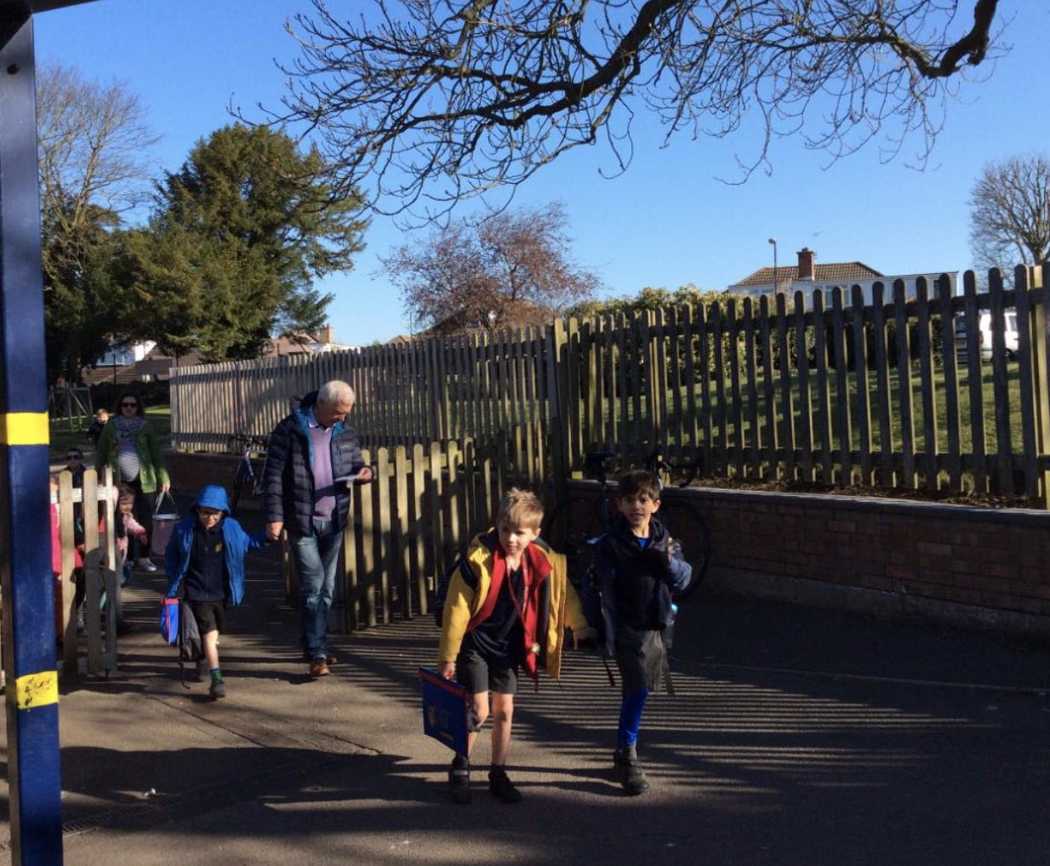
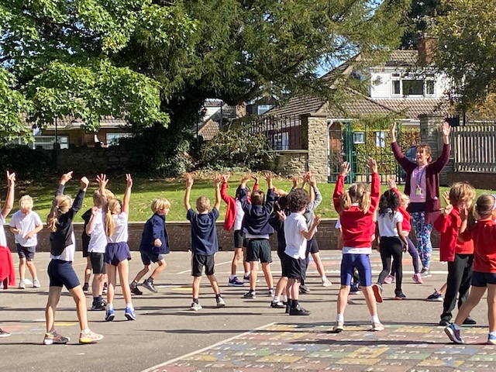
Context:
Local Authority maintained
270 Pupils
Shared Campus
3 form entry

Slide 3
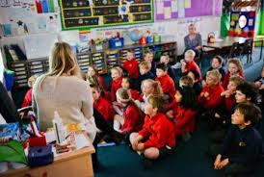
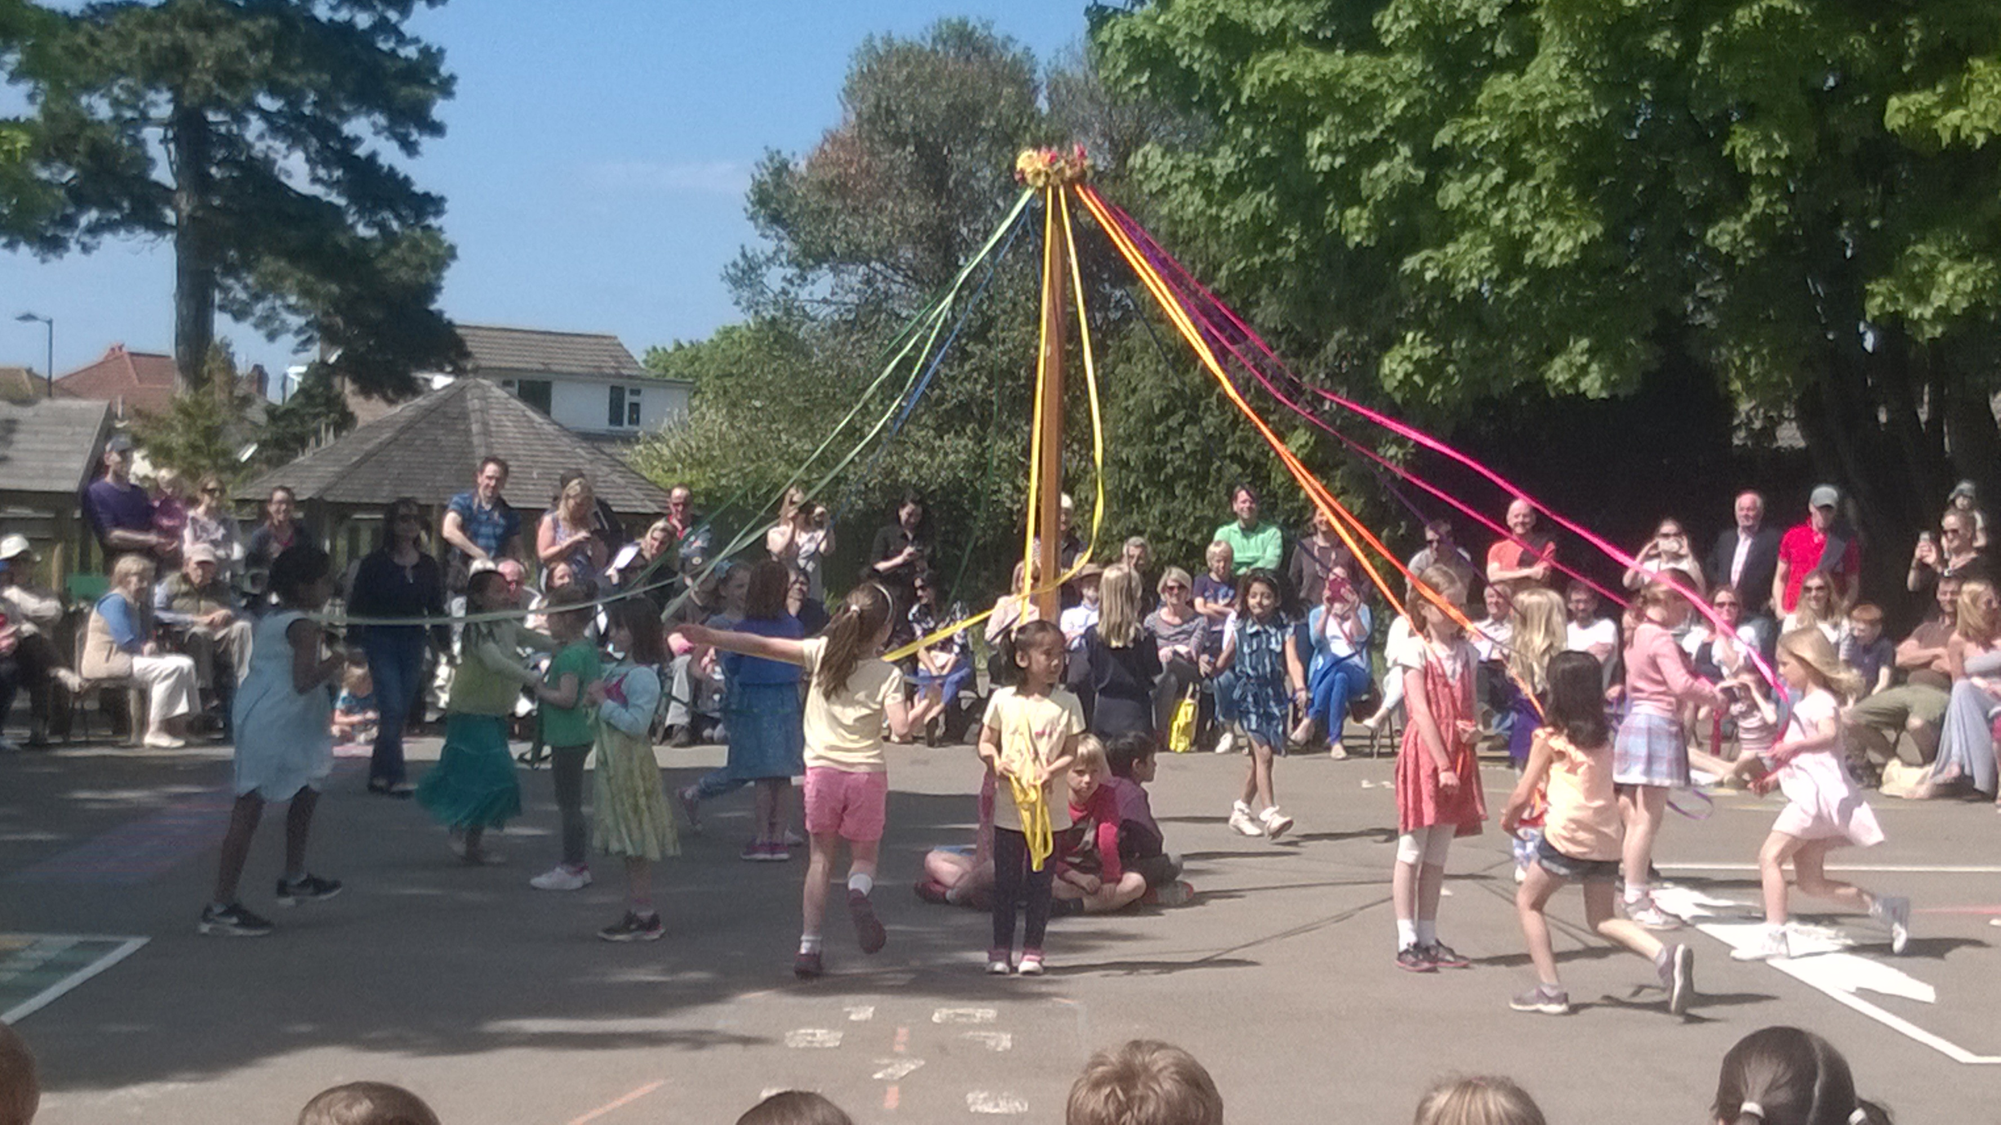
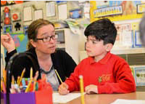
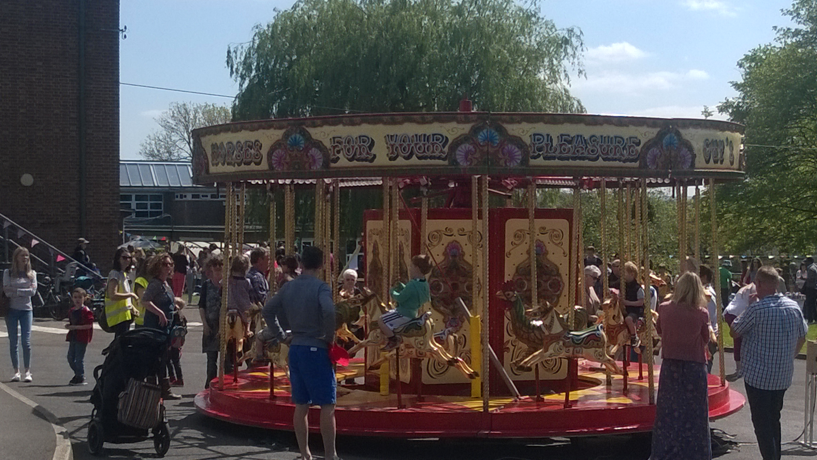
Relationships
Friends of Henleaze Infant School and HENSA May Fair

Slide 4
Outstanding Learning for all
The Henleaze Infant School values we celebrate are:
Respect-Respecting, caring for and supporting others
Feeling Safe-Willingness to take risks, make mistakes and seize learning opportunities; an eagerness to learn, persevere and challenge themselves; awareness of their own and others safety
Inclusion-Valuing similarities and differences between people; working alongside and collaboratively with others
Happiness-Active, joyful participation in learning and play; the ability to recognise strengths, efforts and achievements in themselves and others

Slide 5
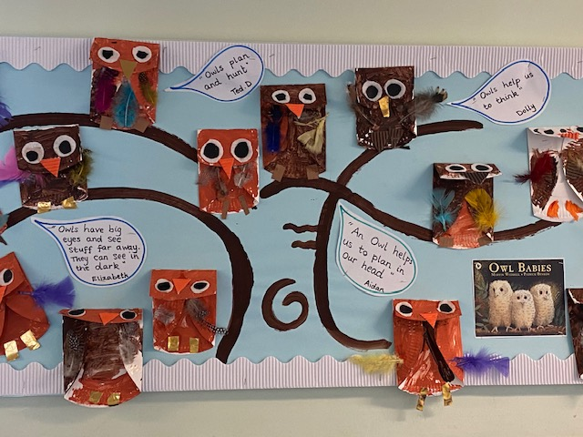
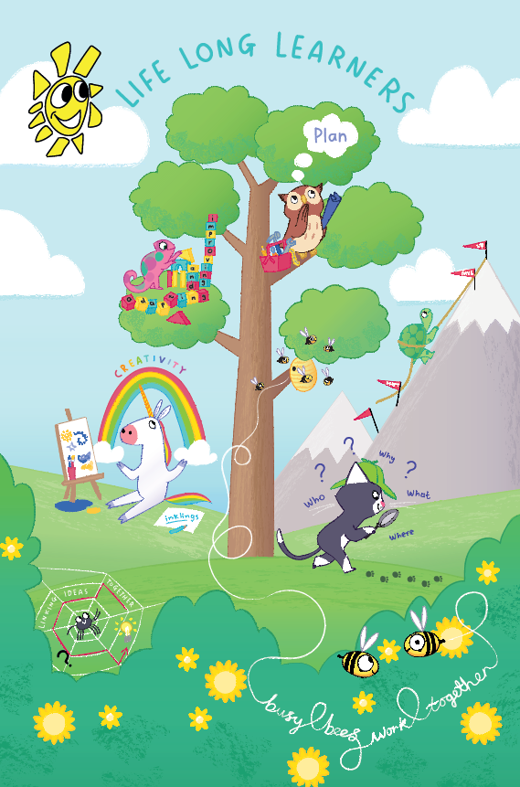
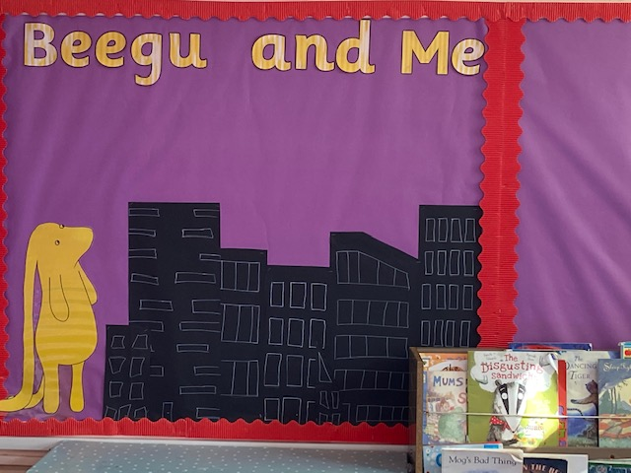
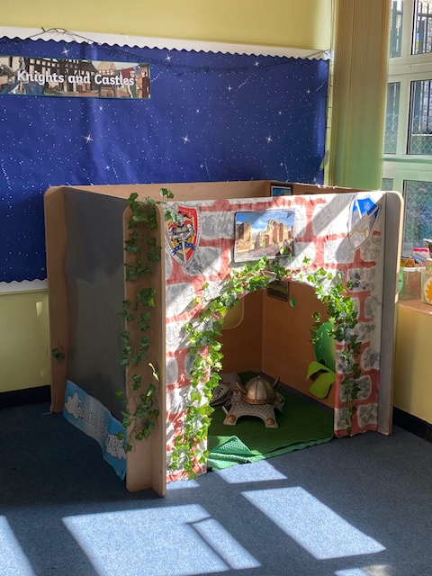
Embedding values through our Curriculum
Experiential and child-centered
Engagement and Challenge
ELLI

Slide 6
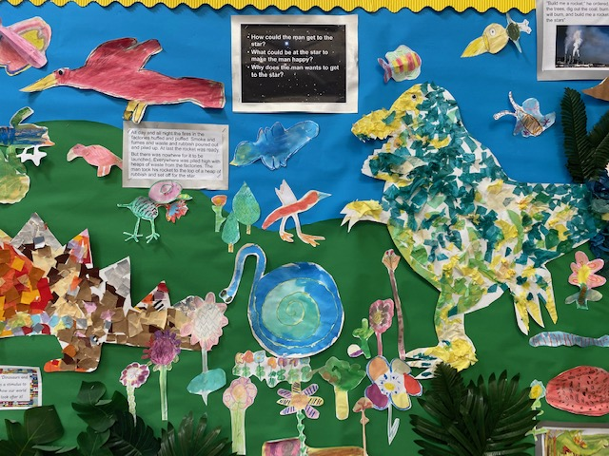
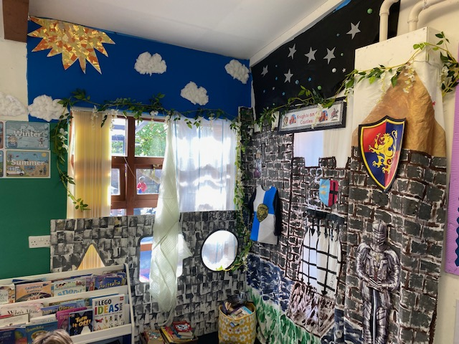
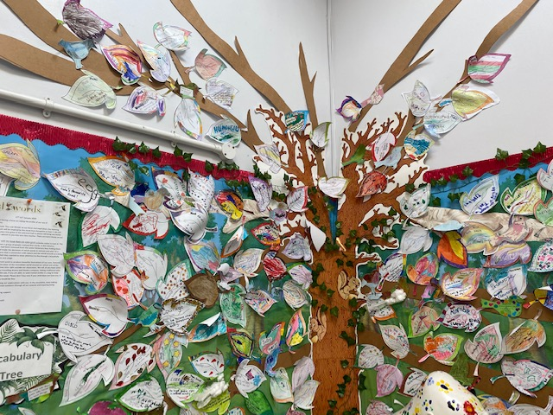
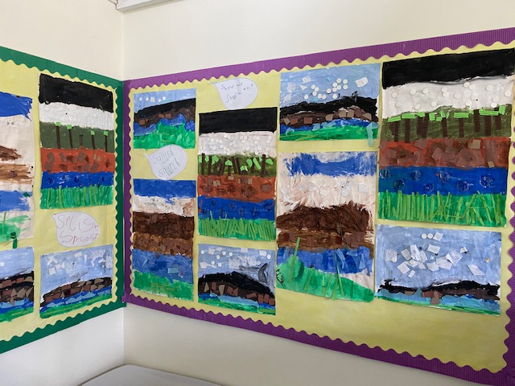
The curriculum at Henleaze Infant School will ensure: Our children learn to celebrate individuality and unique qualities in themselves and others. Our children will feel they belong to our school, our community, our city of Bristol, our country and wider world. Our children are excited to learn, are curious and recognise the awe and wonder around them. Through the teaching of ELLI children have gained the skills to learn effectively and provide the confidence needed to express their thoughts, needs and opinions. They can think creatively to solve problems and meet new challenges with resilience. They have academic ambition and high aspirations for their futures. They have the foundations to grow into responsible, outward looking and generous global citizens showing respect and empathy for others and our world. Our children have the knowledge, skills and emotional wellbeing to lead happy, healthy lives.
Our Curriculum Intent
Creative responses to texts
Family-favourite word tree
Role-Play areas

Slide 7
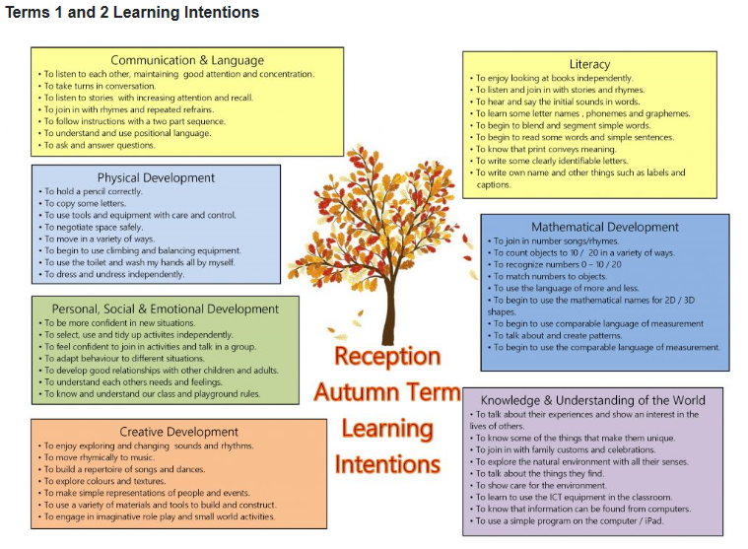
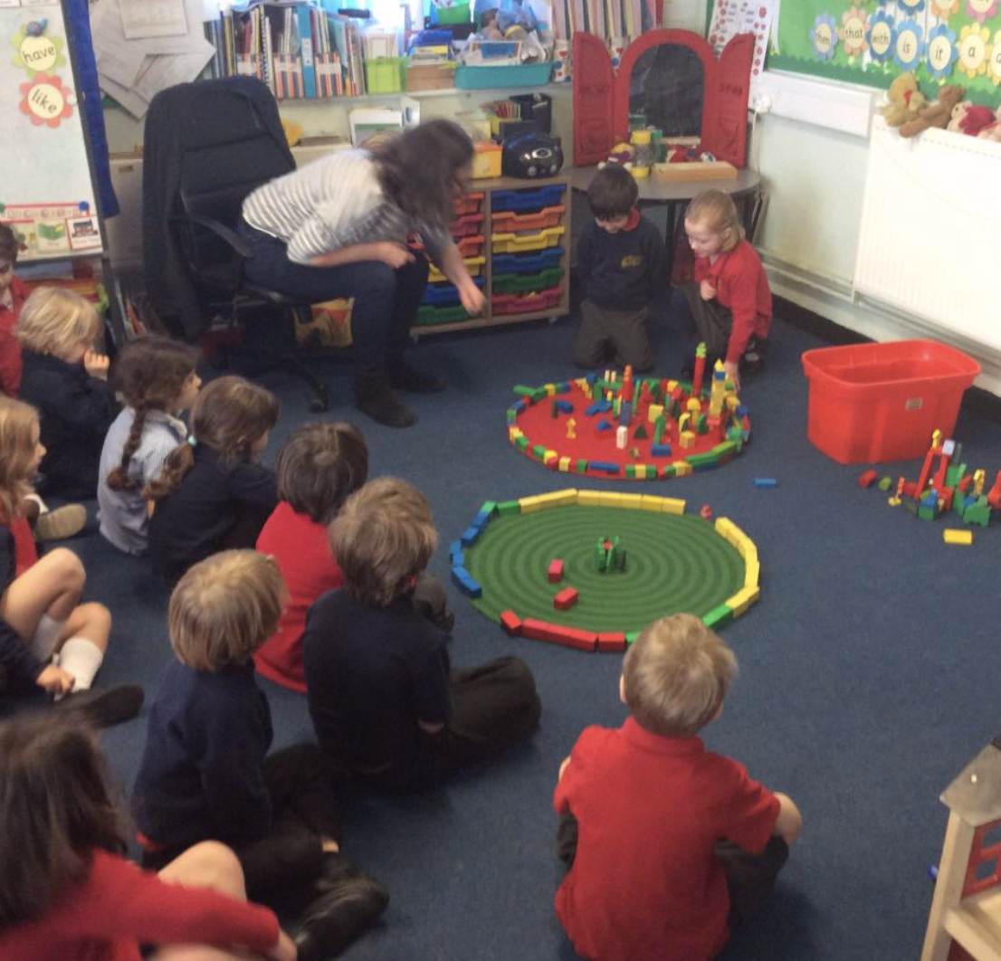
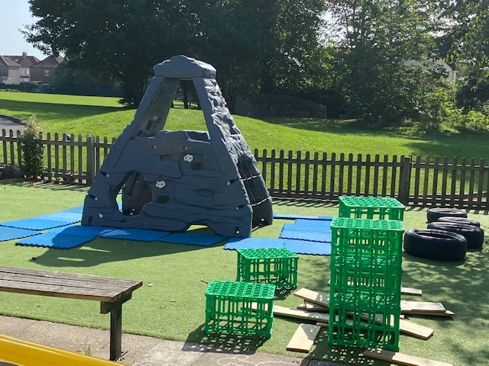
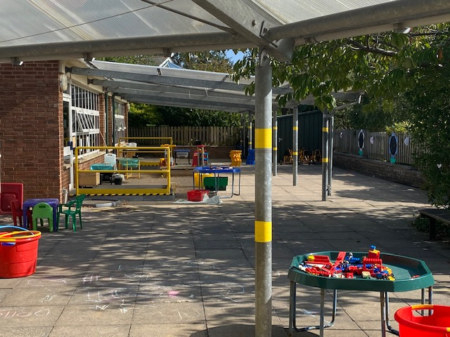
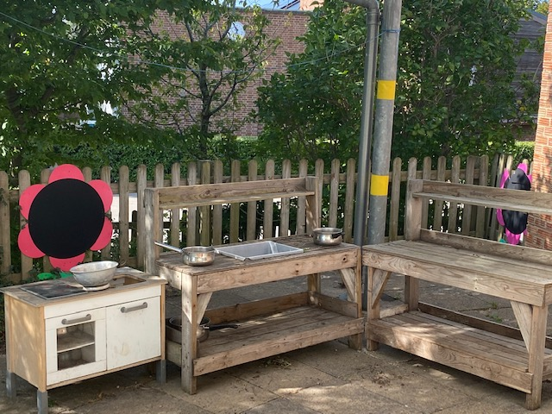
Reception Curriculum: Early Years Foundation stage

Slide 8
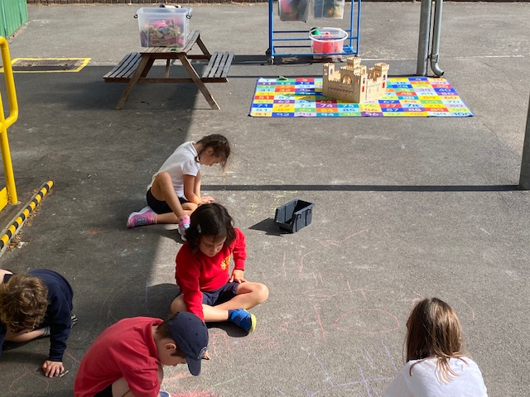
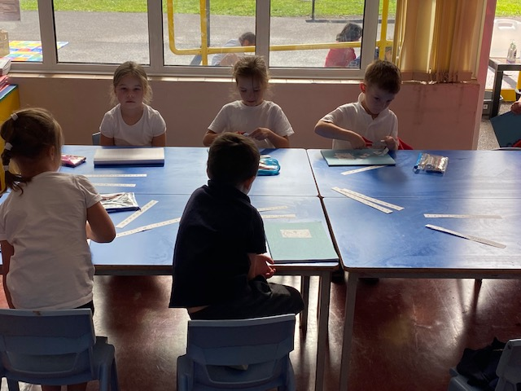
Years 1 and 2: National Curriculum for Key Stage 1

Slide 9
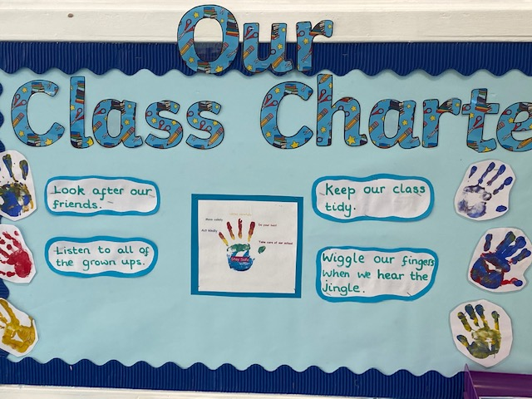
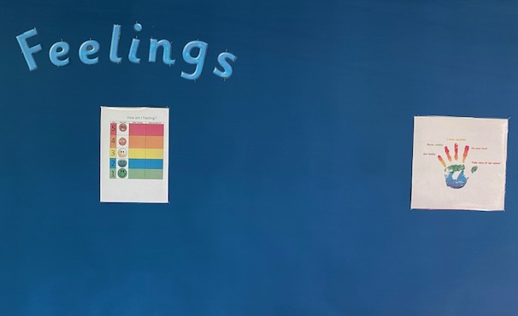
Behaviour Policy
At Henleaze Infant School we believe:
• Positive relationships are critical to a safe learning environment
Behaviour is communication and is often a person’s response to their emotional state
• Children respond well to positive reinforcement
• Children learn best in an ordered environment where boundaries are clear and consistent
Children should be taught age-appropriate strategies to resolve day-to-day conflicts with peers
• Poor behaviour choices may require support and that effective behaviour management should draw on a range of agreed strategies to support children in making appropriate choices

Slide 10
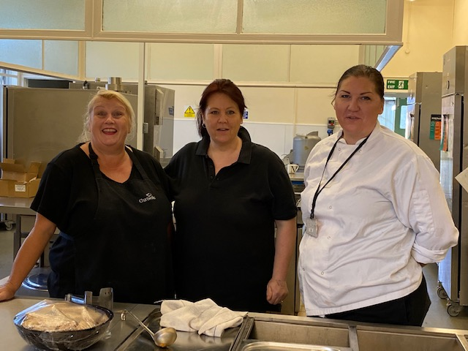
Lunchtime Experience

Slide 11
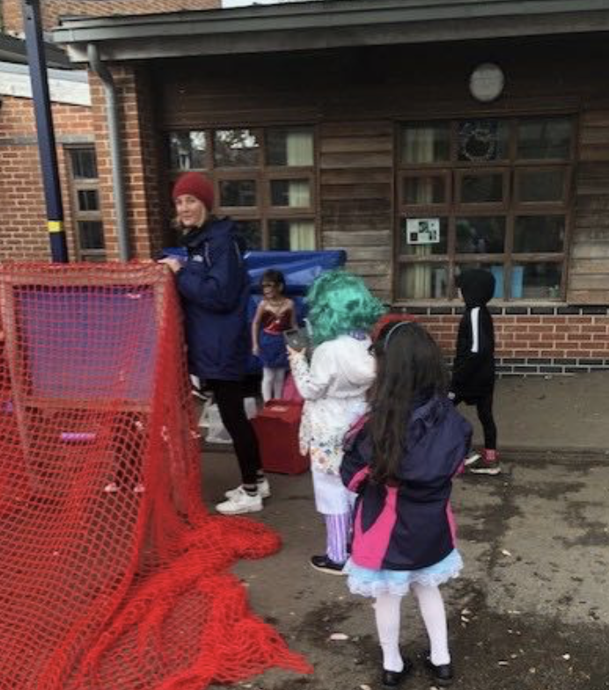
Extra-Curricular Opportunities
Clubs:
Ali’s Get dancing
Shine Sports
Forest School
French Club
Breakfast club
School’s Out
Piano Lessons
Enrichment:
Wow days
Educational Visits
Inter-school events
School Theatre Productions
Our in-house productions

Slide 12
School Tours
Online Booking here

