Slide 1
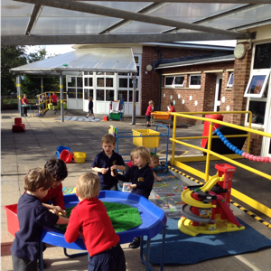
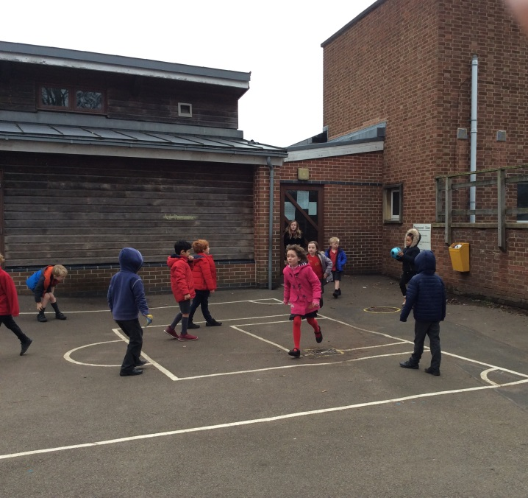
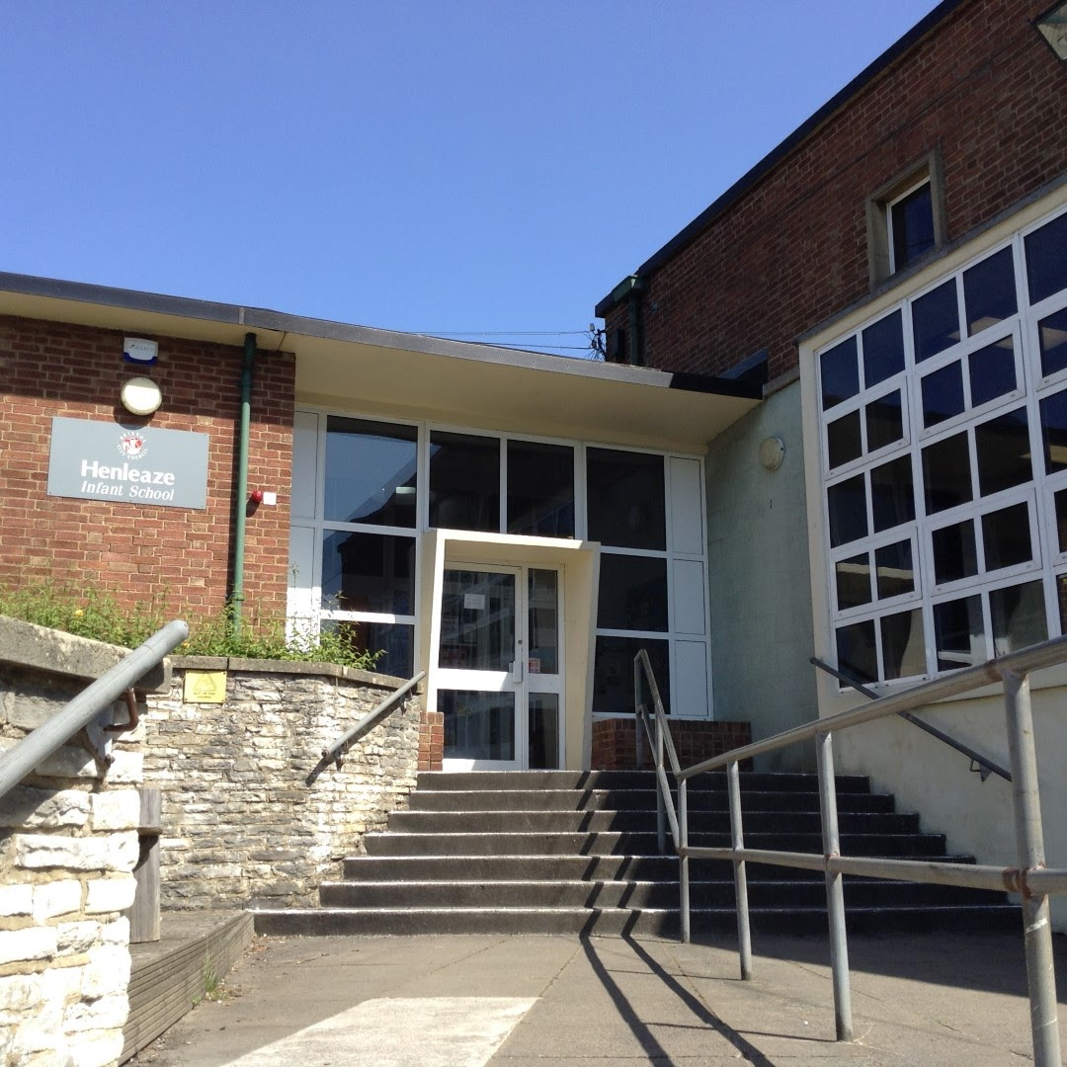
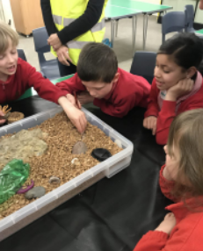
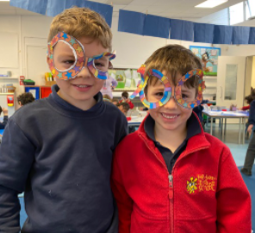
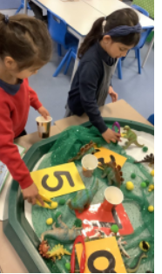
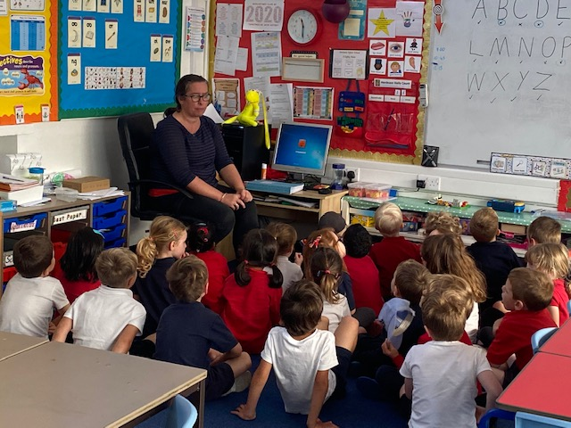
Please see notes section on each page for details.
Notes:
What makes Henleaze Infant School special: Our commitment to providing a warm, safe, engaging learning environment for our children based on our deep understanding of the what young children need to thrive. We are all Infant specialists and tailor our curriculum and policies to the age range of our children. We know that young children are highly capable and provide a broad and ambitious curriculum.

Slide 2
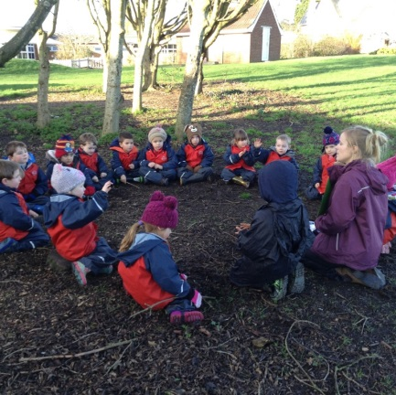
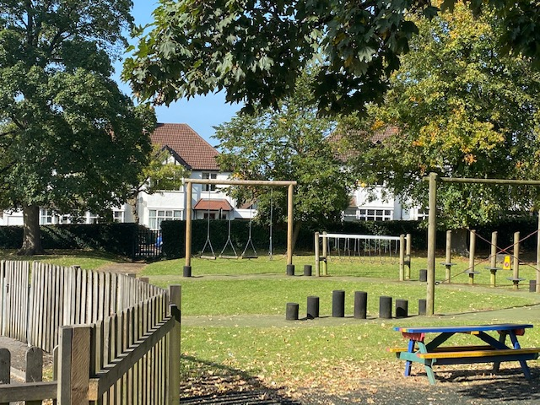
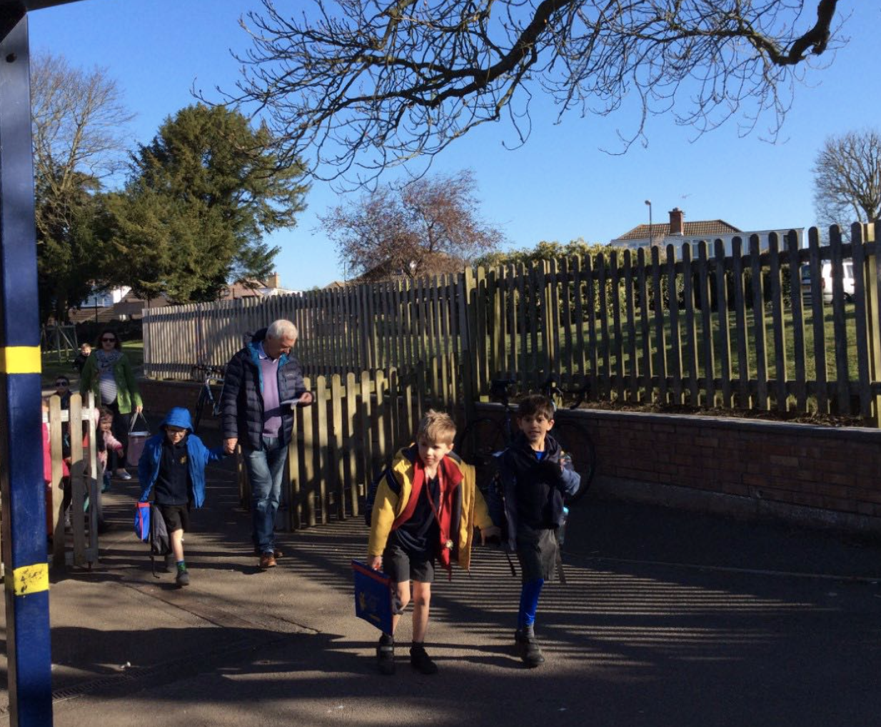
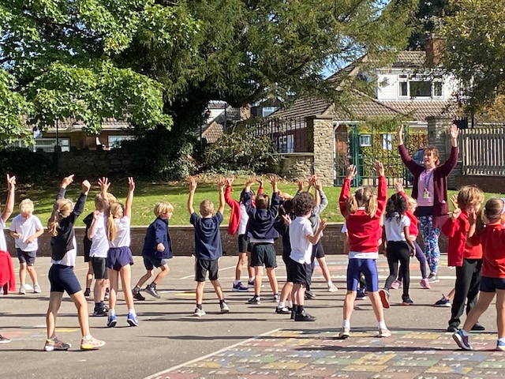
Context:
Local Authority maintained
Maximum 270 Pupils
Shared Campus
3 form entry
Skilled Governors
Talented, committed staff team
Notes:
Following a 2018 Ofsted which judged the school to be ‘Requires Improvement’ there was a change in leadership. The school embarked on a journey of rapid improvement, maintaining the child-centred ethos, whilst ensuring the curriculum developments enabled all groups of pupils to make progress to reach their potential. This included staff working with teaching schools to learn about the newest developments in education, improving resources and increasing the monitoring of progress to ensure no child is left behind. We work closely with henleaze Junior school not only to ensure a smooth and well-managed transition for children, but also in curriculum developments and enrichment. Both schools work within NW24 partnership providing a wider network of school development and inter-school enrichment activities.

Slide 3
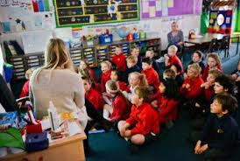
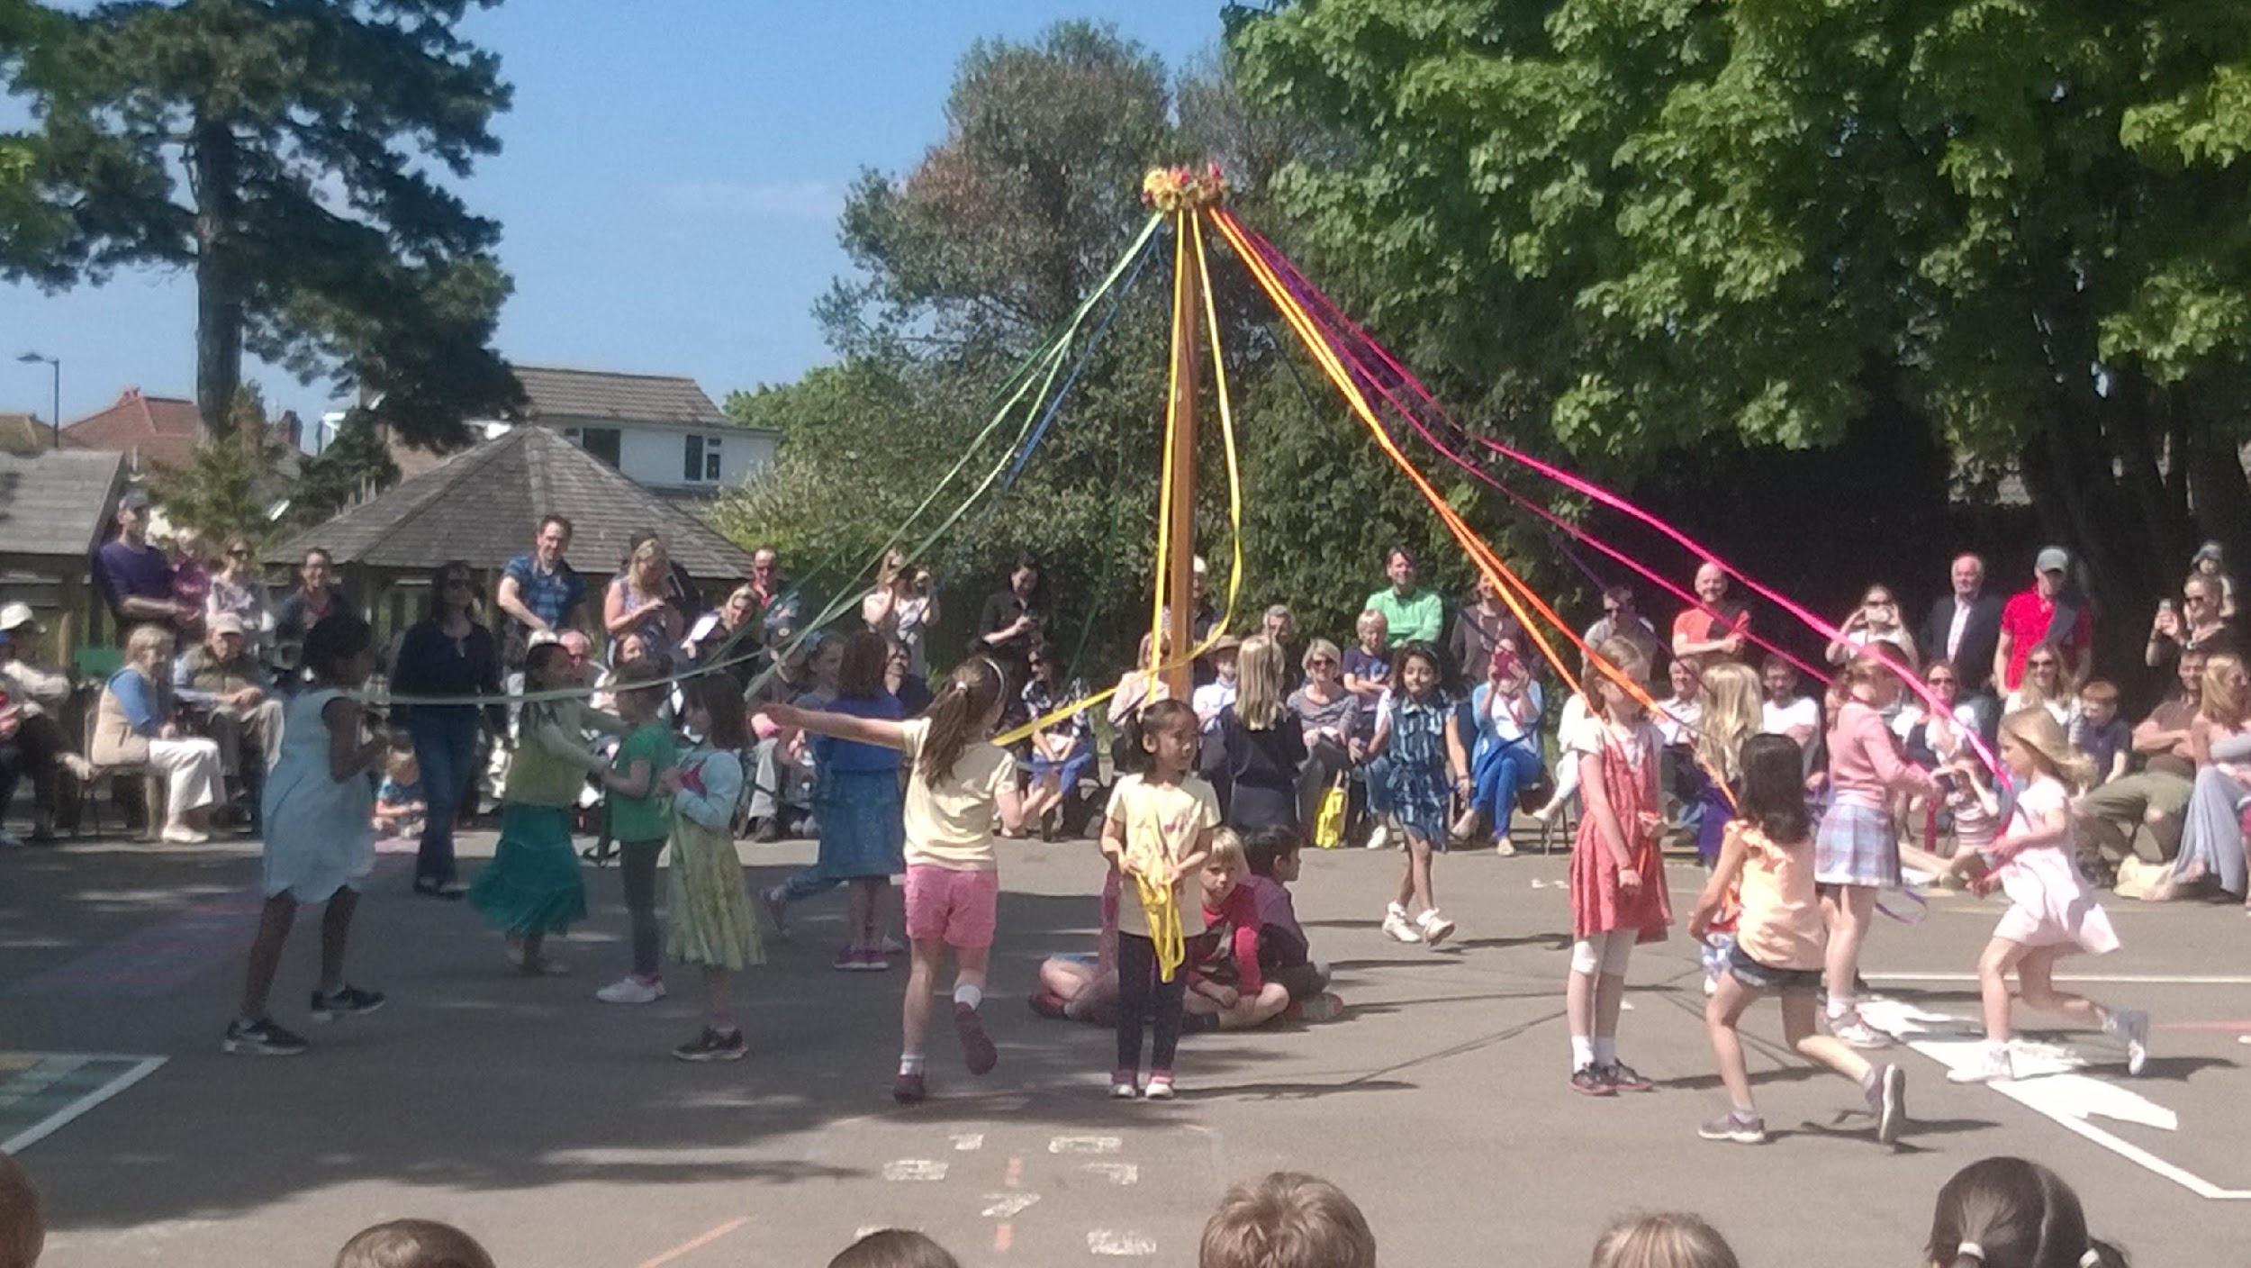
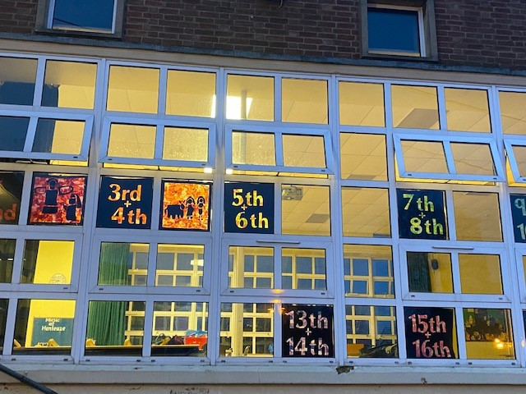
Relationships
FHIS
Notes:
We highly value the role parents play in supporting their child’s educational and social-emotional developments. We understand behavior as a communicator of emotion and work with parents to understand changes in behaviour to ensure we support the root cause. We provide planned and incidental opportunities to understand, celebrate and discuss learning, including through our class blogs that are updated each week to ensure parents are fully involved in their child’s education. Staff at henleaze Infants are committed, with many long-serving team members, meaning they are part of community. This leads to a knowledge of families and the community. Beyond our school team, we work closely with School’s Out henleaze our after school club provider. Alongside our in-house Breakfast Club team SOH provide a safe and familiar environment to ensure children are well supported through our wrap around care offer. Friends of Henleaze Infant School (FHIS) are our fantastic parents’ association. Beyond their amazing fundraising efforts, the events and communication systems they have developed enable new and existing families to feel an integral and welcome part of our community.

Slide 4
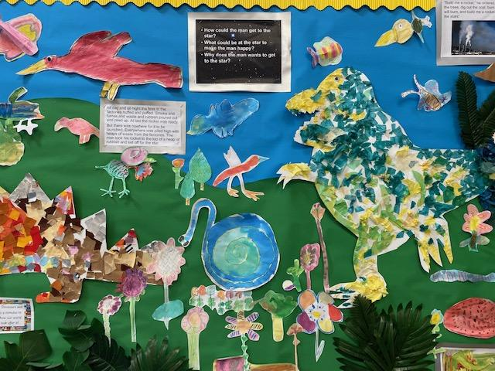
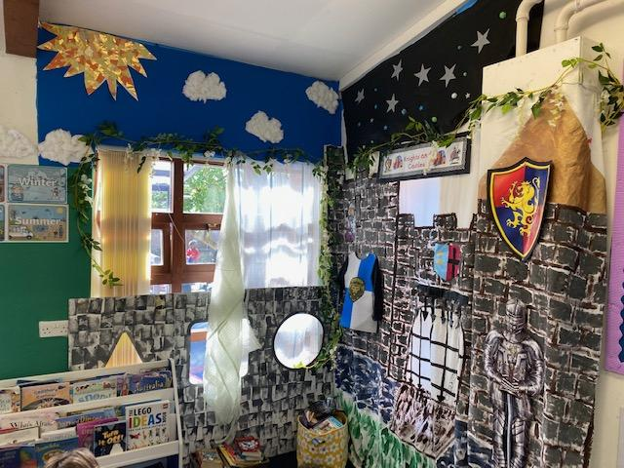
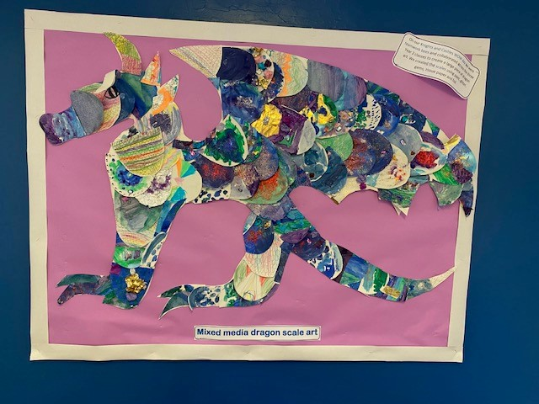
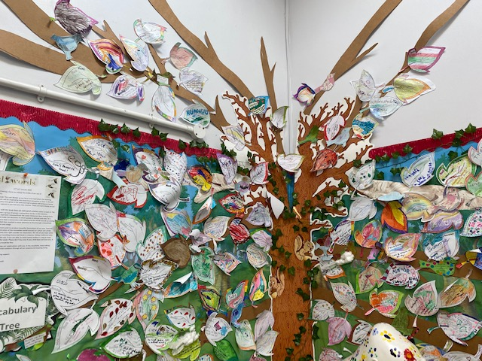
The curriculum at Henleaze Infant School will ensure: Our children learn to celebrate individuality and unique qualities in themselves and others. Our children will feel they belong to our school, our community, our city of Bristol, our country and wider world. Our children are excited to learn, are curious and recognise the awe and wonder around them. Through the teaching of ELLI children have gained the skills to learn effectively and provide the confidence needed to express their thoughts, needs and opinions. They can think creatively to solve problems and meet new challenges with resilience. They have academic ambition and high aspirations for their futures. They have the foundations to grow into responsible, outward looking and generous global citizens showing respect and empathy for others and our world. Our children have the knowledge, skills and emotional wellbeing to lead happy, healthy lives.
Key Features:
Experiential
Hands on
Creativity
Enrichment
High expectations & Challenge
School Council
Diversity
Ambition-role models
Resilience
Language-rich environment
Texts
Library
Performances

Slide 5
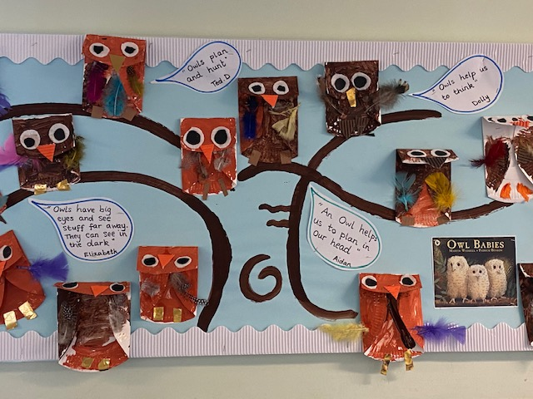
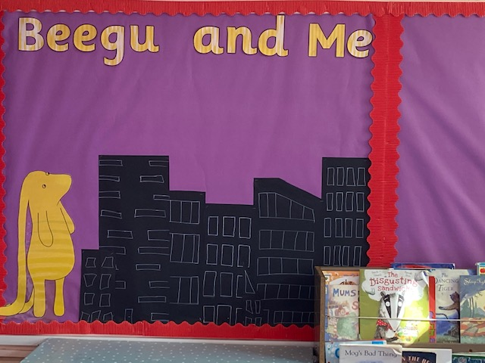
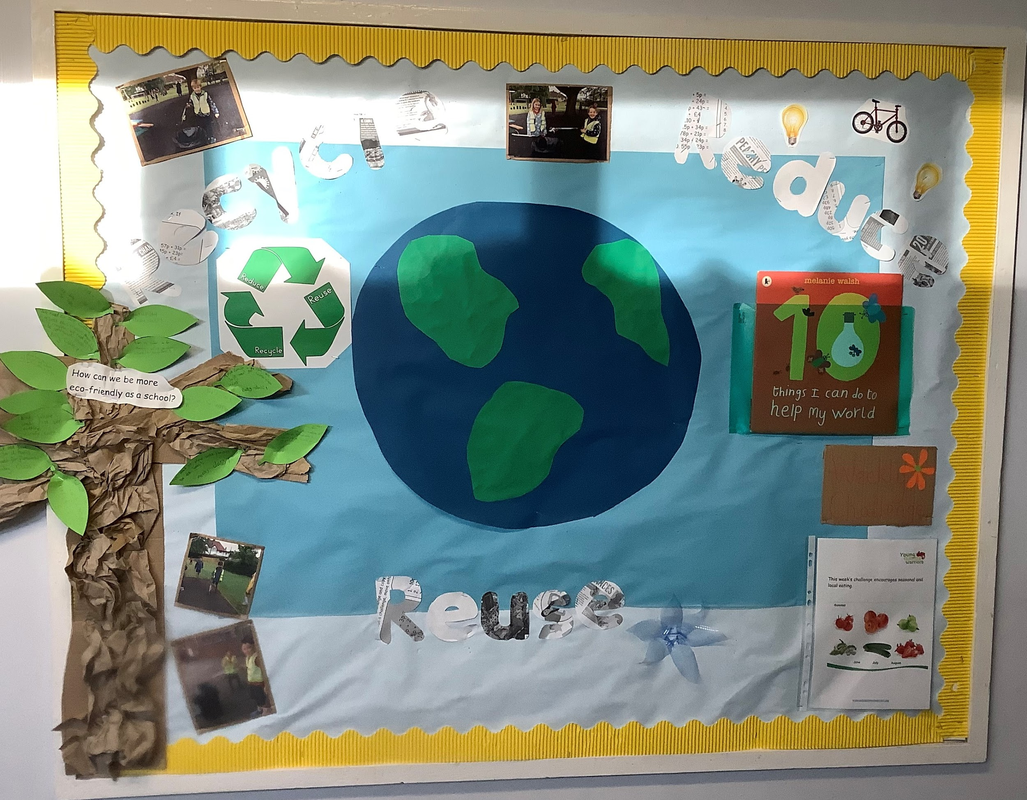
Embedding values through our Curriculum
Notes:
Henleaze Infant School strongly believe in a curriculum that enables children to learn the skills of effective life-long learners to support their attainment and progress. We develop these skills using ELLI (Effective Lifelong Learning Inventory) which started out as a research project at Bristol University. It uses seven animal characters to represent the seven identified characteristics of effective learners. Through the use of age-appropriate, child-friendly characters linked to a story, we give the children a shared language of learning and an understanding of the skills they need in order to become effective learners. Teaching and learning is woven throughout the curriculum and is a planned element in school assemblies and celebrations.

Slide 6
Outstanding Learning for all
The Henleaze Infant School values we celebrate are:
Respect-Respecting, caring for and supporting others
Feeling Safe-Willingness to take risks, make mistakes and seize learning opportunities; an eagerness to learn, persevere and challenge themselves; awareness of their own and others safety
Inclusion-Valuing similarities and differences between people; working alongside and collaboratively with others
Happiness-Active, joyful participation in learning and play; the ability to recognise strengths, efforts and achievements in themselves and others
Notes:
Recognised by Ofsted that children feel safe and happy to come to school

Slide 7
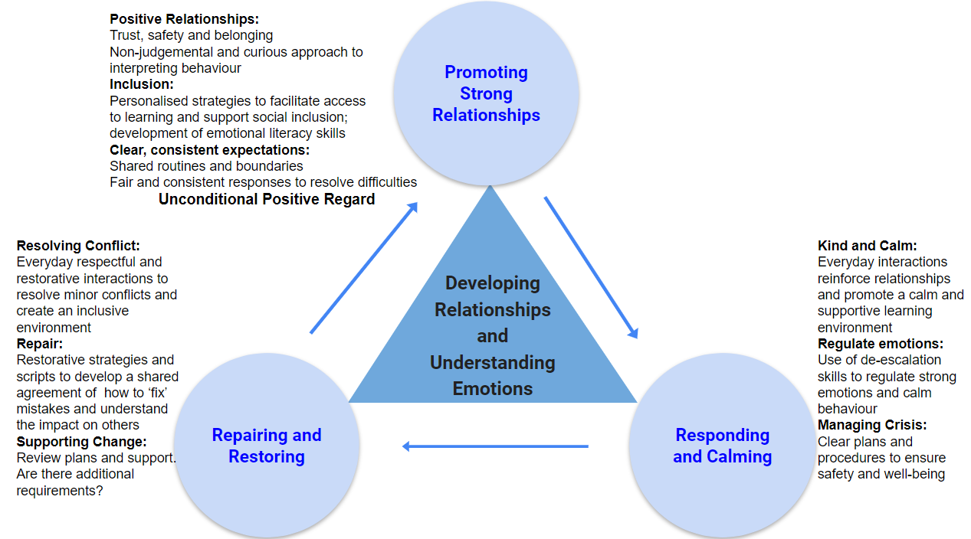
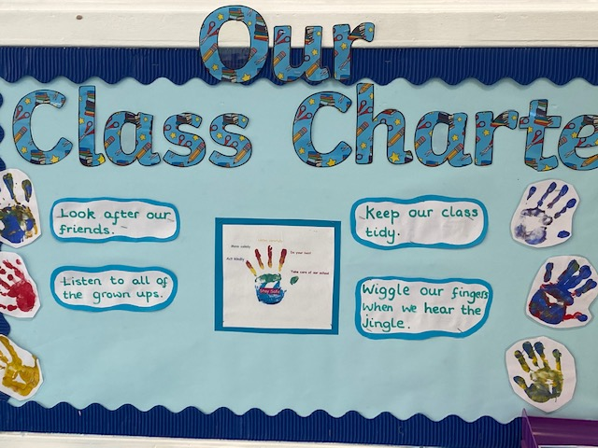
Behaviour Policy

Slide 8
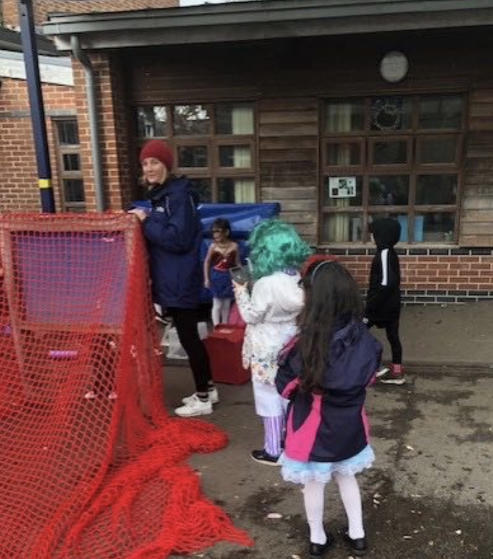
Extra-Curricular Opportunities
Clubs:
Shine Sports and dance
Forest School
School’s Out
Breakfast club
Piano
Choir
Enrichment:
Educational visits
Visitors
Wow days
Sports Leaders
Responsibilities:
School Council
Eco Council
Notes:
As an Infant school our offer for the youngest children often exceeds that of other primary schools. We know our children are very capable and do not wish to limit their enrichment opportunities.

Slide 9
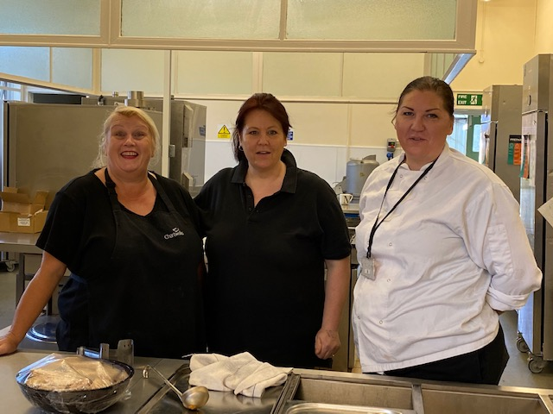
Lunch
Notes:
Each child is entitled to a free school lunch under the Universal Free School Meals offer for children under the age of 7. Our lunchtime team know and understand how important this part of the day is and communicate effectively with teachers and the wider staff. Shine Sports coaches are part of our lunchtime team and provide opportunities for sports activities as well as traditional playground games alongside our lunchtime supervisors.

Slide 10
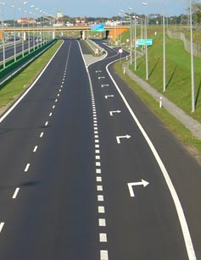
Our School Improvement Journey
Leadership and management structures to drive improvement
Ensuring consistent, high quality maths and reading teaching
Using quality texts to make connections in learning and inspire our children as writers
Right turn: Remote learning and recovery curriculum
Wider curriculum development to fulfil our aims for an exciting, ambitious and broad curriculum
Notes:
From the 2018 Ofsted the school has worked to rapidly address all identified areas of improvement. Our school is an happy, vibrant learning environment that continues to result in very good outcomes for children.

