Slide 1
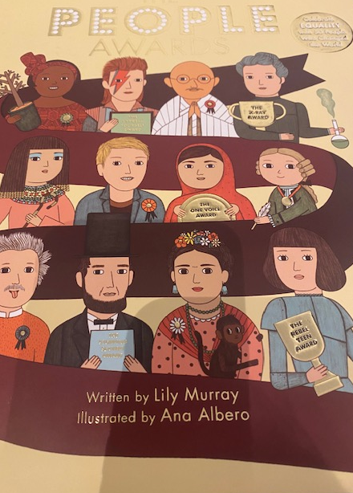
Dreams and Goals
We have been thinking about what it takes to achieve our dreams,
This book was a gift from Mrs Hopkins who worked at our school. It is full of people who have achieved great things.
On each slide you can click to hear questions or information from Mrs Fricker

Slide 2
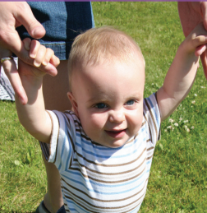
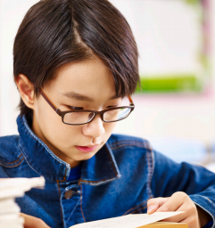
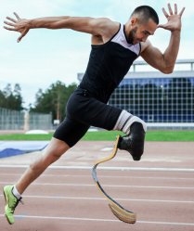
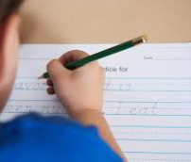
Achieving Your Dreams and Goals

Slide 3
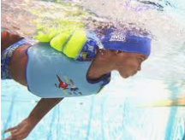
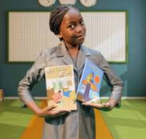
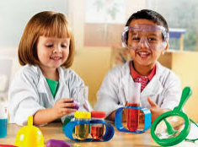
What is your future
goal?
To swim?
To be an athlete?
To help the environment by growing your own food?
To be an author?
To be a scientist and discover new ideas?
Notes:
Teacher to talk about one of their goals. Paired talk about goals

Slide 4
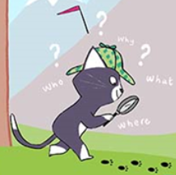

Slide 5
Click here for video

Slide 6
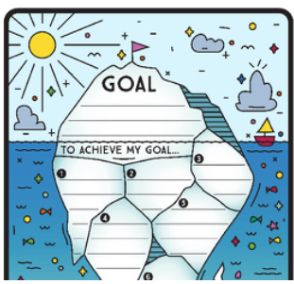
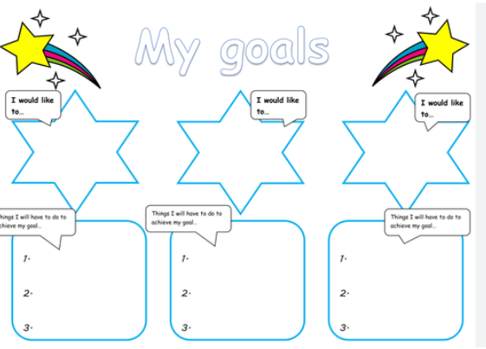
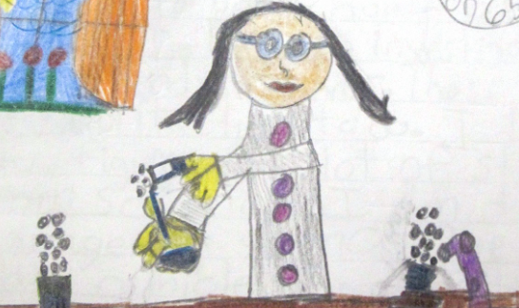
Your task:Create a poster to show how you will achieve your goal
This could be a story map, pictures of the steps you need to follow, or picture of you doing the thing you want to achieve

