Slide 1
Be kind, be curious, be you
Writing Curriculum Information
Meeting
12th January 2024

Slide 2
Be kind, be curious, be you
Henleaze Infant School - Writing Project –
The Physical Act of Writing –
But we know so much is needed before
we pick up a pencil!
Watch this video.
Handwriting

Slide 3
Henleaze Writing Project 2023-24
Part 1: Handwriting - Physical
Pencil Grip
Posture
Gross and Fine Motor Control
Correct Formation-Joins start in Y2
Part 2: Introduce Term 3
Spelling - explicit teaching each day
(This will also include working with the Junior School)
7 main steps to becoming a fluent writer – 2 of the earliest are handwriting and spelling!

Slide 4
Statutory Framework for the Early Years Foundation Stage
ELG: Writing Children at the expected level of development will: - Write recognisable letters, most of which are correctly formed; - Spell words by identifying sounds in them and representing the sounds with a letter or letters; - Write simple phrases and sentences that can be read by others.
Communication and Language Goals and Self-Regulation – Importance of all of these before we can even begin to expect the writing with all it’s known complexities.
At the end of the Reception
Year, the children are assessed
against these as best fit.

Slide 5
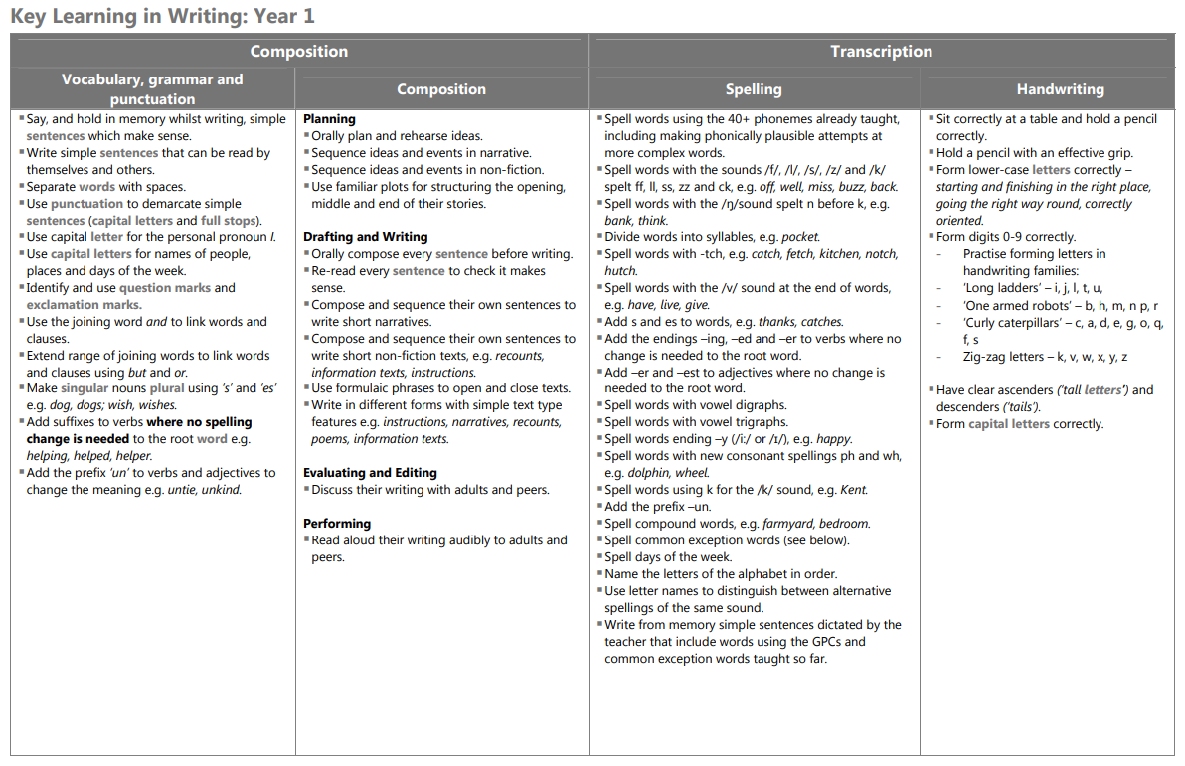

Slide 6
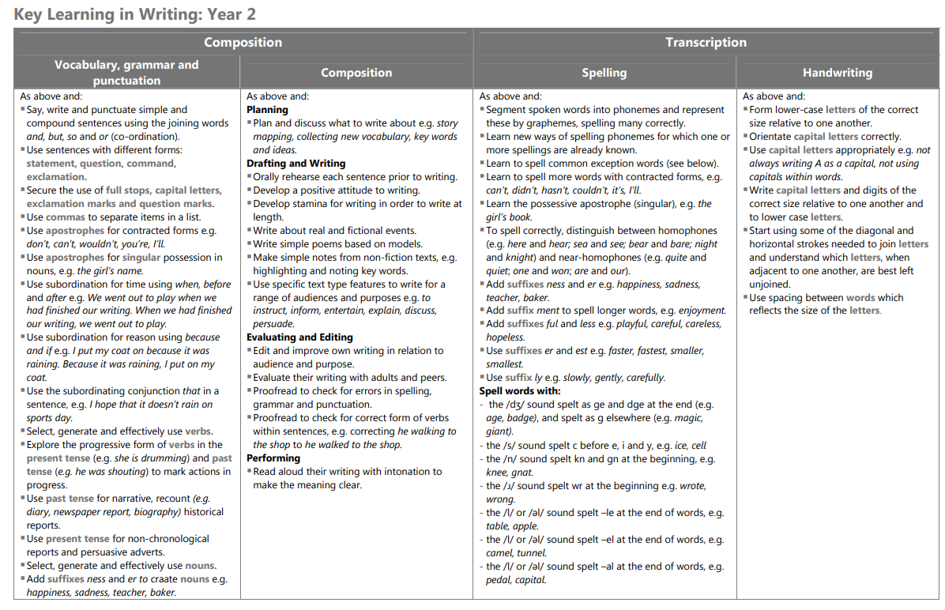
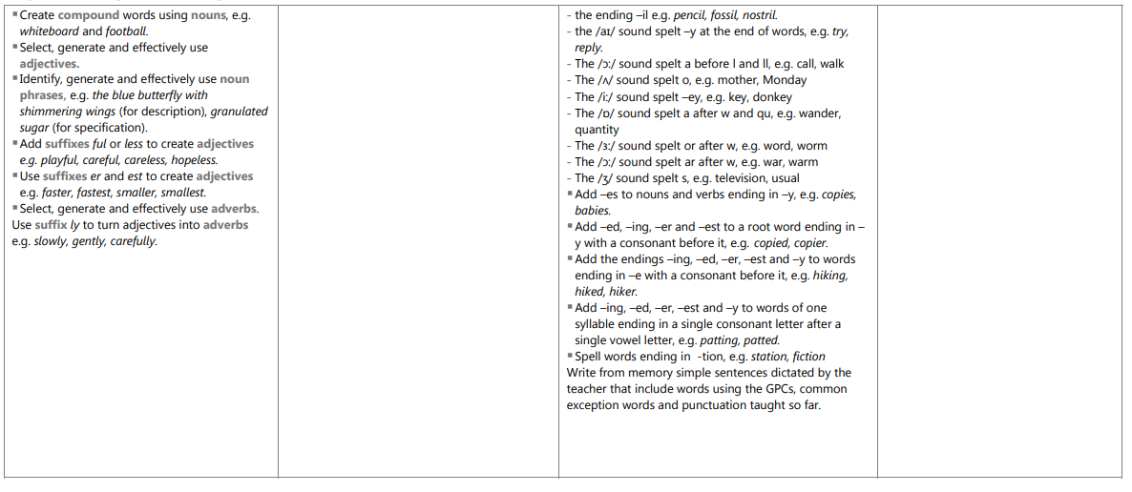

Slide 7
English – Broken down into 5 parts:
Speaking & Listening
Phonics
Reading
Writing
SPAG (Spelling, Punctuation and Grammar)

Slide 8
Writing
~ Writing progress is closely linked to reading progress
We aim to:
~ Teach using a variety of genre: stories, poetry, factual recounts and instructions
~Link to quality texts used to ‘hook’ the children in. For example, Year 2 are currently using the story of ‘Look Up!’
~ Make writing meaningful, purposeful and fun…with all children seeing themselves as authors!

Slide 9
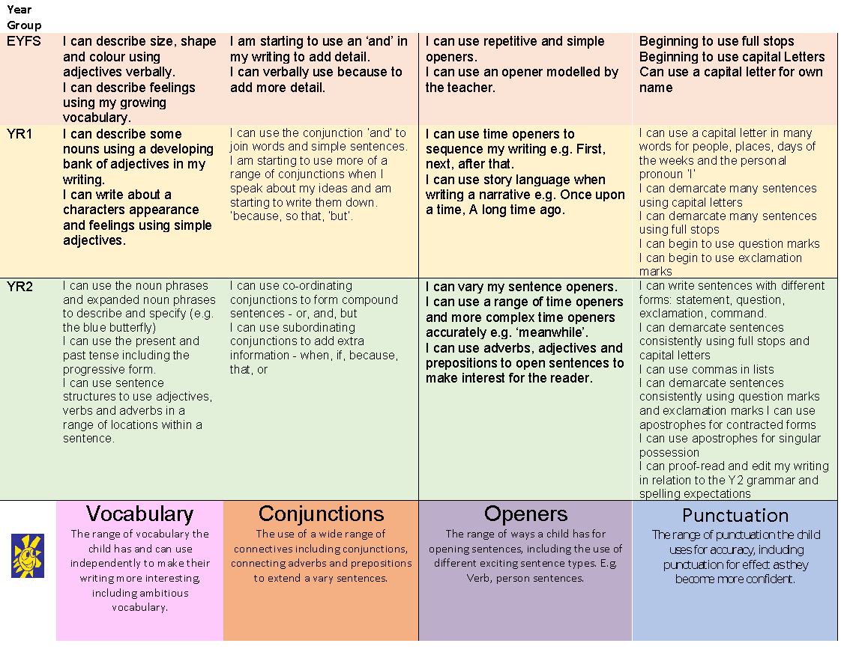
Summary of main skills used in each year group

Slide 10
SPAG – Spelling, Punctuation and Grammar
In the National Curriculum, there is a strong emphasis on SPAG to enable children to develop automaticity in the core writing elements
Spelling is key! Regular class based activities to help reinforce accuracy in spelling of high frequency words and common exception words (words that cannot be sounded out with phonemes they currently know).
Learning the use of different sentence punctuation ? . , !
KS1 children will be taught SPAG vocabulary connected to their learning-noun, verb, adjective, suffix, prefix…
Handwriting explicitly taught weekly in class – focus is on accurate letter formation before joining. Starting letters in the correct place is key to this. This is linked to their phonics and spelling learning through the week. Please support at home.
Check the class blog for the English focus each week.

Slide 11
Remember that children need to be able to read these words before attempting to spell them. These are the lists that is the aim for the end of each year group.

Slide 12
Whole School Focus: Simple, but effective
Writing our own names correctly! Ask them to write their names correctly at available opportunities.
So important from EYFS up, as gets harder to correct.
Incorrect letter formation when writing their name can stick. Often, these letters are the ones that then stay incorrect throughout their writing.
We know that once bad habits
are adopted in writing,
they are hard to correct!

Slide 13
Writing – Helping at home
Initially you will have encouraged your child to draw and discuss the drawings.
Show an interest in, and ask questions about, the things your child draws, and may try to write.
Asking your child to write for a ‘real’ purpose is great at home. Lists, cards, letters, memo reminder notes.
Children need to form their letters correctly. We focus on this every day across all areas of the curriculum that involve literacy and writing. This is a very important step because as children move up through the school, they begin to learn and master joined handwriting which is only possible with the correct letter formation, starting in the correct place, holding a pencil in a tripod grip. Please support this at home.
As they move through the school, children write using an extended vocabulary. We model using expressive language and actively thinking of an alternative for simple words such as ‘said’, ‘happy’ or ‘nice’ in our writing. We encourage children to do the same and extend their vocabulary, using a variety of words.
Ambitious words may require own attempts at spelling, but encourage the correct spelling of words you know they should know!

Slide 14
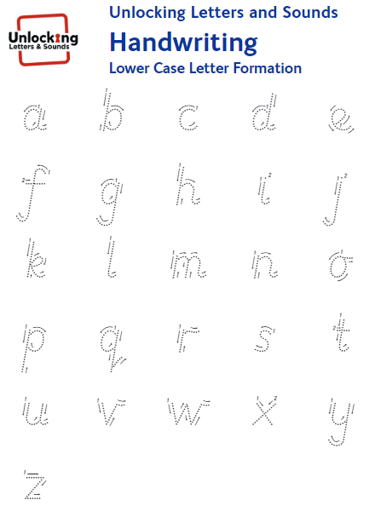
Starting position of letters is vital for correct formation and future joining.

Slide 17
Useful Links to Supporting your child with their pencil control
Correct Wrist Position
Left Handed Writing Tips
Tripod Grip and How to hold a pencil

Slide 18
To give you an idea of the expectations for writing; this is an example of an end of Key Stage (end of Year 2) piece of writing at the expected level for this age.

Slide 19
Summary
Writing is a very hard and complex skill, made up of many smaller parts/steps to have success .
Many skills are needed to all be performed at the same time to have success.
Correct formation is key to support speed, neatness, future joining – ultimately having one less thing to think about – becomes automatic!
Good handwriting skills support spelling.
Helps with muscle development so becomes less tiring.
A child can see straight away their progress, even during one piece of writing.
Why do we write?
Communication = If we can’t read it we have already failed!
Remember - It’s another developmental stage. Just as we all walked at different times so too we will master writing when we and our bodies are ready.

Slide 20
Questions?
We understand that this is a lot of information to take in so…
Check out the website and….
Thank you

